Slide 1
News Classification and Sentiment Analysis
Mentor:
Mr. Subhash C Gupta
Submitted By:
Varuna Gupta (BE/25077/13)
Shiven Purohit (BE/25093/13)

Slide 2
Introduction
The advent use of news online social media such as articles, blogs, message boards, and news channels, and in general Web content has dramatically changed the way people look at various things around them. The majority of the content we read today is on the negative aspects of various things. Reading such news is spreading negativity among the people.
The purpose of this project is emphasized on classification of online news into positive and negative categories. This would enable us to focus only on the good news which will help spread positivity around society and would allow people to think positively.

Slide 3
Objectives
Provide a platform for serving good news and create a positive environment.
Give an easy interface to the user to fetch the news articles based on their genre and opinion from multiple sources.
Give maximum information to the user using minimum time and resources.

Slide 4
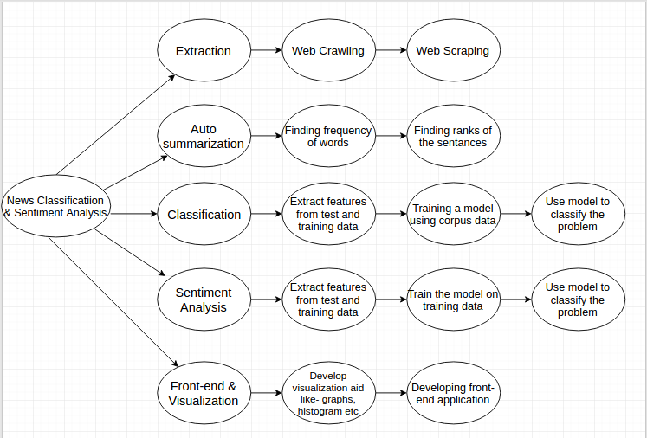
Process Decomposition

Slide 5
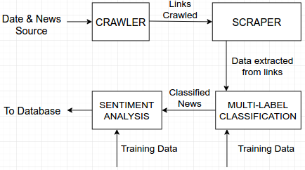
Basic Structure

Slide 6
Implementation

Slide 7
Module 1 – EXTRACTION
Part 1 – Crawler – Overview
In this part of the module, we have designed a Crawler bot which when given input date and news domain fetches us all the news links from that date published in the news domain.
These links are used by Web Scraper ( part 2) to fetch the headline, author, published data and story of the news hit.
INPUT – Date in YYYY-MM-DD format and the news domain.
OUTPUT – a text file named bs.txt with all the news links

Slide 8
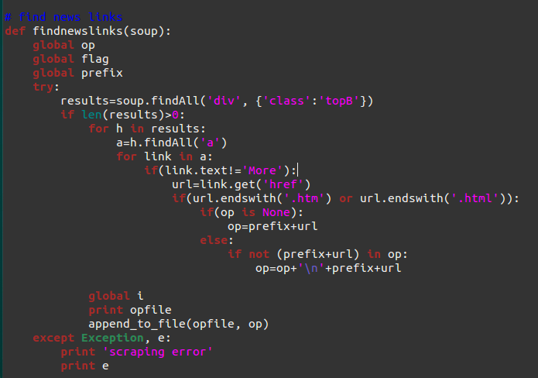
Module 1 – EXTRACTION
Part 1 – Crawler – Overview
findnewslinks() function finds the legitimate news links from the page source.

Slide 9
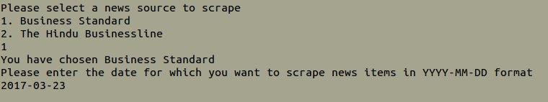
Module 1 – EXTRACTION
Part 1 – Crawler – Overview
INPUT:

Slide 10
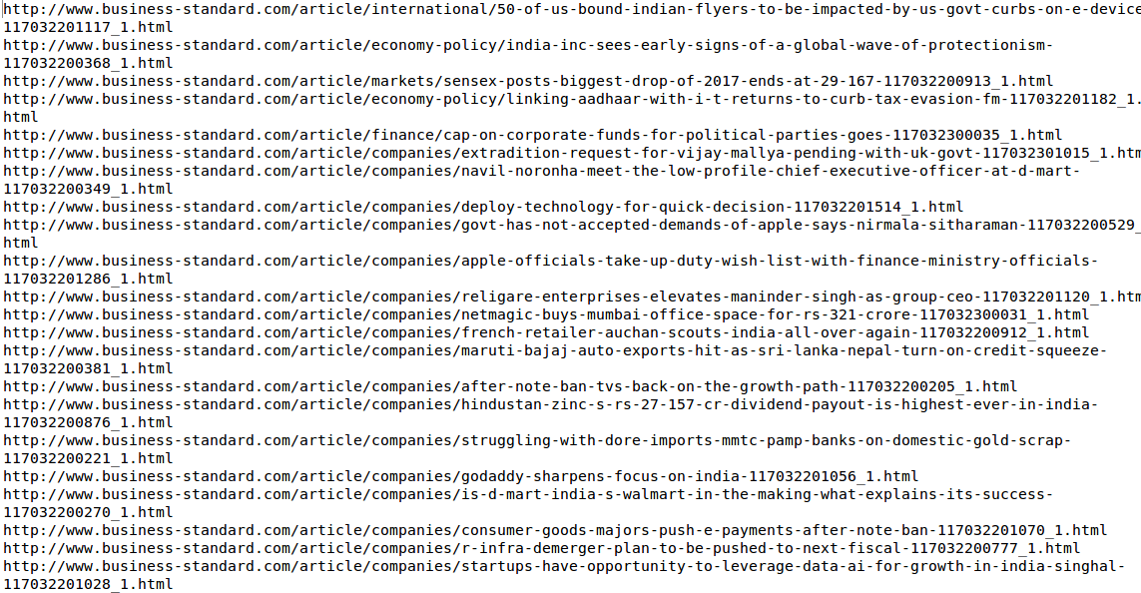
Module 1 – EXTRACTION
Part 1 – Crawler – Overview
OUTPUT:

Slide 11
Module 1 – EXTRACTION
Part 2 – Scraper – Overview
In this part of the module, we have designed a web scraper bot which when given html links fetches us all the data from the news links like headline, author, published date and story.
This data is stored in a SQLite database file and is further used for auto summarization, sentiment analysis and multi-label classification.
INPUT : links from bs.txt file and number of links to parse
OUTPUT : .sqlite file with data given in a tabular format.

Slide 12

Module 1 – EXTRACTION
Part 2 – Scraper – Overview
INPUT : The script shows the total number of news stories crawled by the crawler and asks how many to process.

Slide 13
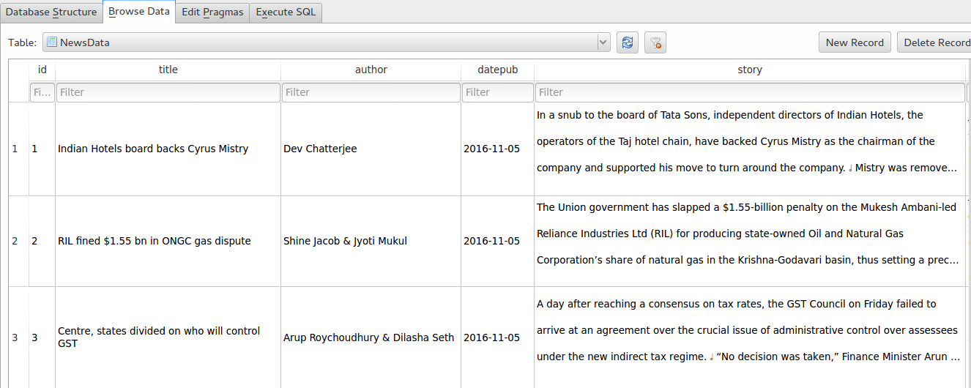
Module 1 – EXTRACTION
Part 2 – Scraper – Overview
OUTPUT : The script produces a .sqlite output file which contains all the news details in database table format.

Slide 14
Module 2- AUTOSUMMARIZATION
In this module, we have summarized news stories into 2 or 3 sentences.
First, we calculate the frequency of all the words in the story (less the stopwords like it, a, an, the and etc.) and give higher rank to higher frequency word.
Second, we calculate the rank of the sentence using word frequencies by adding the frequency of all the words to compute frequency of sentences.
Finally, we select 2 or 3 high rank sentences (sentences with high frequency count).

Slide 15
Module 2- AUTOSUMMARIZATION
METHODOLOGY:
Download the article from Web.
Split the article into words and eliminate the stopwords (the, is..)
Find the frequency of the words.
Rank the words according to the frequency.
For each sentence, find the score of how important the words in that sentence are.
Rank the sentences by that score.

Slide 16
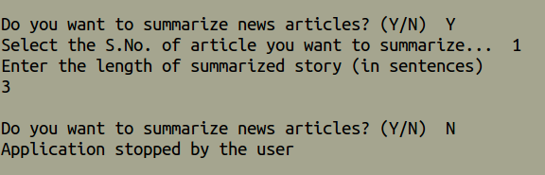
Module 2- AUTOSUMMARIZATION
INPUT:
The script takes the ‘story’ from .sqlite file of the selected article number and the number of sentences to which article must be summarized.

Slide 17
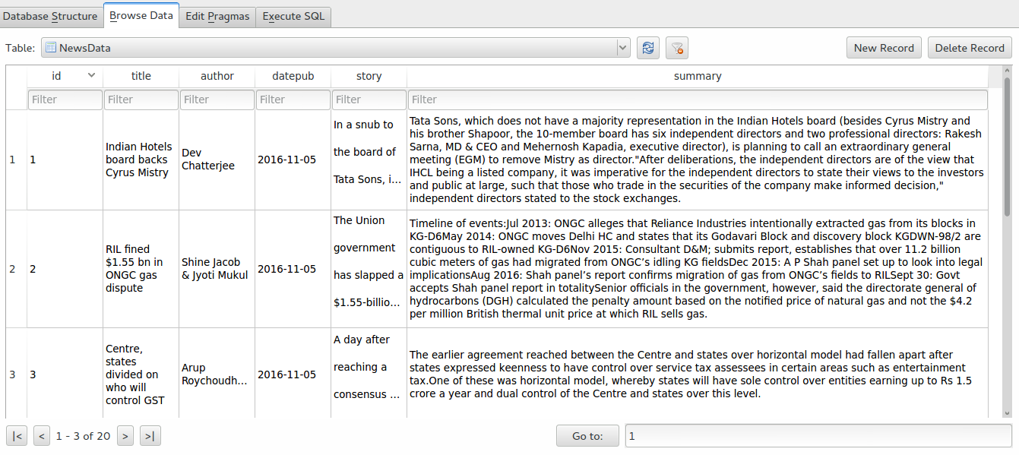
Module 2- AUTOSUMMARIZATION
OUTPUT:
In the output, we have the updated .sqlite file with summary of the news articles.

Slide 18
Module 3- CLASSIFICATION
In this module, the news article are classified under various labels like sports, national, international, others etc. The algorithm used in multi-label classification is Naïve Bayes Algorithm.
INPUT: The updated .sqlite file with summarized news article
OUTPUT: The output adds a column in the .sqlite file that holds the label of the news article in which they are classified.

Slide 19
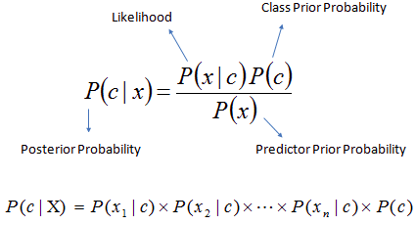
Module 3- CLASSIFICATION
METHODOLOGY:
Naïve Bayes Classifier: It is a classification technique based on Bayes’ theorem with an assumption of independence among predictors. It works on Bayes’ theorem of probability to predict the class of unknown data set.

Slide 20
Module 3- CLASSIFICATION
METHODOLOGY:
Training Data summary:
Test Data summary:
We will compare the training data summary and test data summary using Bayes’ probabilistic theorem to classify the test data.

Slide 21
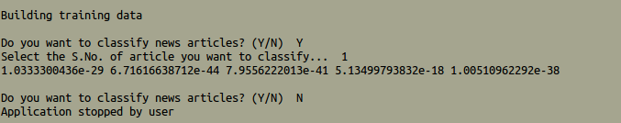
Module 3- CLASSIFICATION
INPUT:
Input to the classifier is the summarized news article and the article number which needs to be classified.

Slide 22
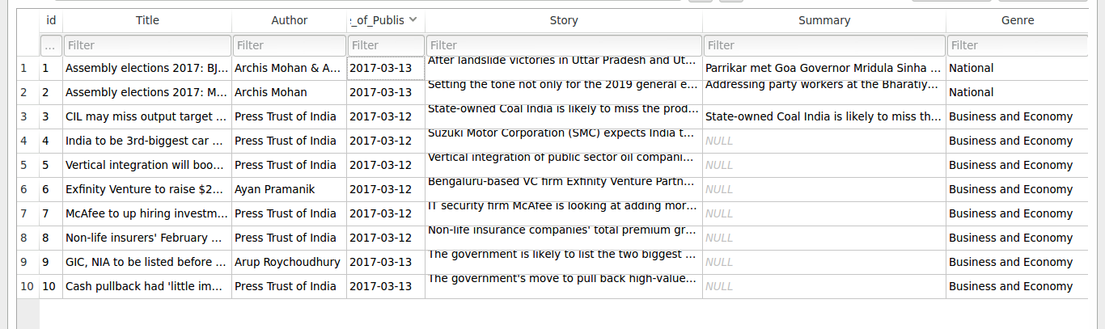
Module 3- CLASSIFICATION
OUTPUT:
Output of the classifier is the label to which the selected news article is classified.

Slide 23
Module 4 – SENTIMENT ANALYSIS
In this module, with the news article summarized by their story and classified under different sections, now the articles are opinionated under positive and negative news.
INPUT : The updated .sqlite file with summarized and classified news and the article number whose sentiment is to be analyzed.
OUTPUT : An extra column is added to the .sqlite file which holds the sentiment of the news article.

Slide 24
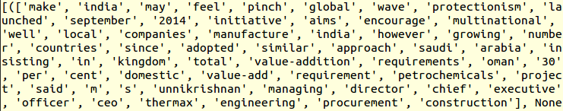
Module 4 – SENTIMENT ANALYSIS
Methodology :
Training Data Summary:
Test Data Summary:
We will build the training data using SentiWordNet dictionary and then compare our test data with training data into positive and negative news.

Slide 25
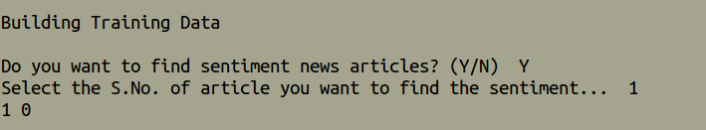
Module 4 – SENTIMENT ANALYSIS
INPUT :
Input is the article number whose sentiment is to be analyzed.

Slide 26
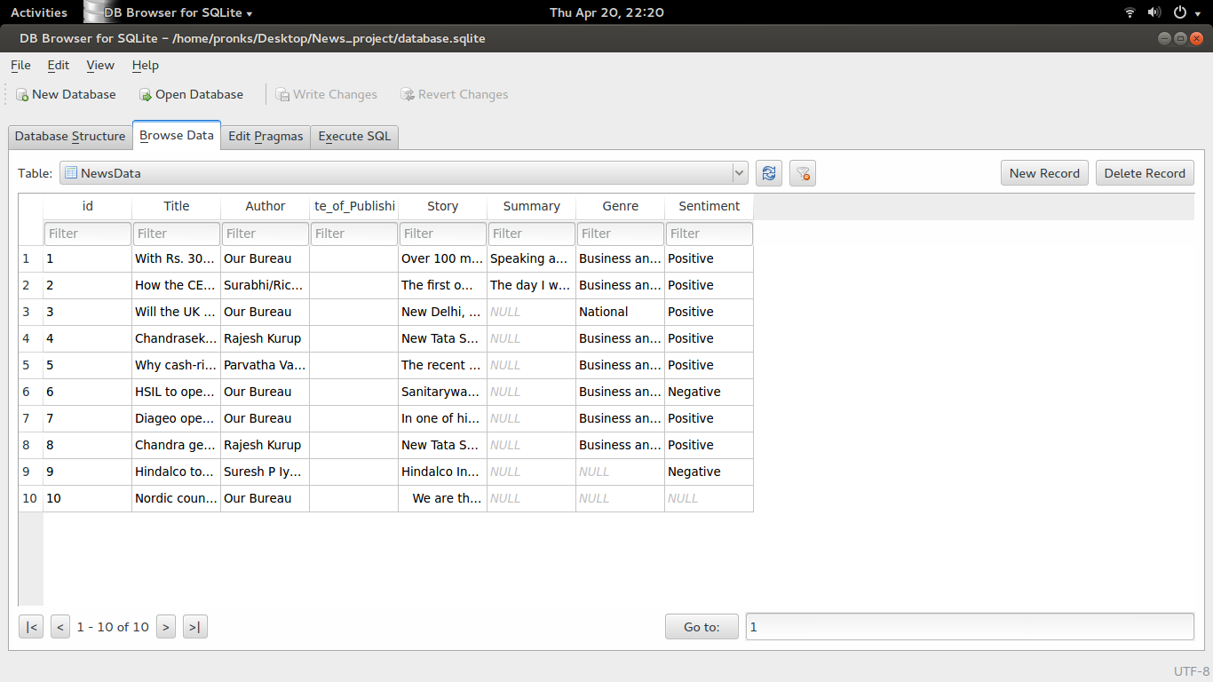
Module 4 – SENTIMENT ANALYSIS
OUTPUT :
Output of the module is the updated .sqlite file that contains the sentiment of the selected news article.

Slide 27
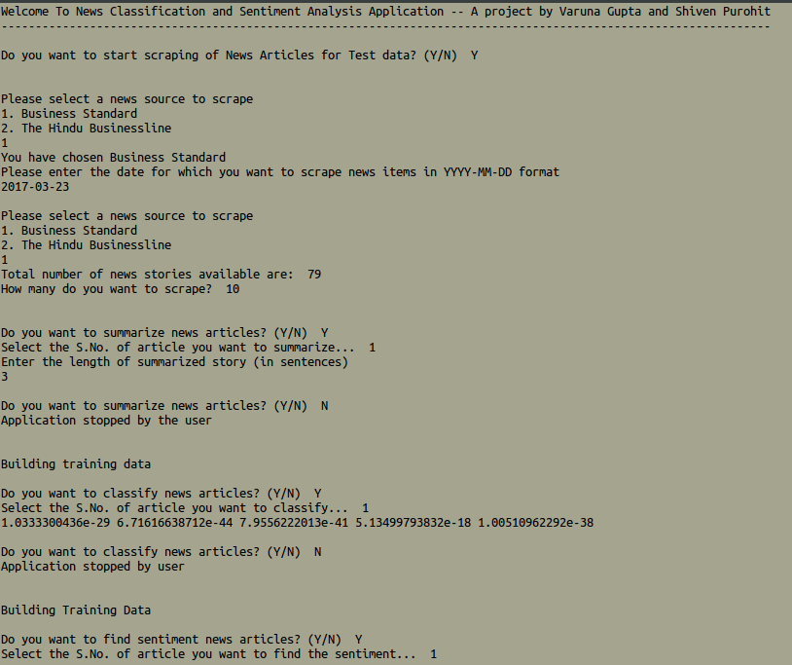
TEST RUN CASE

Slide 28
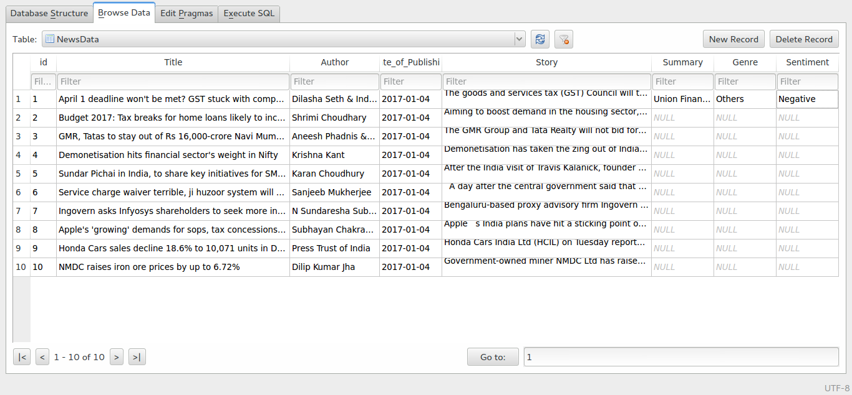
TEST RUN CASE

Slide 29
REFERENCES
Zi-jun ; Wei-gang Wu ; Jing Xiao ; Jun Zhang ; Rui-Zhang Huang ; Ou Liu 2009. Keyword Combination Extraction in Text Categorization Based on Ant Colony Optimization. Soft Computing and Pattern Recognition, 2009. SOCPAR ’09. International Conference of, vol, no., pp. 430-435, 4-7 Dec. 2009. DOI : 10.1109/soCPaR.2009.90
Fabrizio Sebastiani. 2002. Machine Learning in automated text categorization ACM Computer Survey 34, 1(March 2002), 1-47. DOI= 10.1145/505282.505283
Sentiment Analysis of movie reviews by V.K. Singh, R. Piryani, A. Uddin and P. Waila.
K. Nigam, J. Lafferty, and McCallum. Using maximum entropy for text classification, IJCAI-99 Workshop on Machine Learning for Information Filtering, pages 61-67, 1999.

Slide 30
THANK YOU

